Slide 1





IntroDuction To Version Controlling With Git and Microsoft Github
About Author
Name : Tashik Moin Sheikh
University : National University Of Computer & Emerging Sciences, FAST-Karachi.
Email : TashikMoinSheikh@Gmail.Com
Mobile : +92 3000 212027
Beta – Microsoft Student Partner

Slide 2

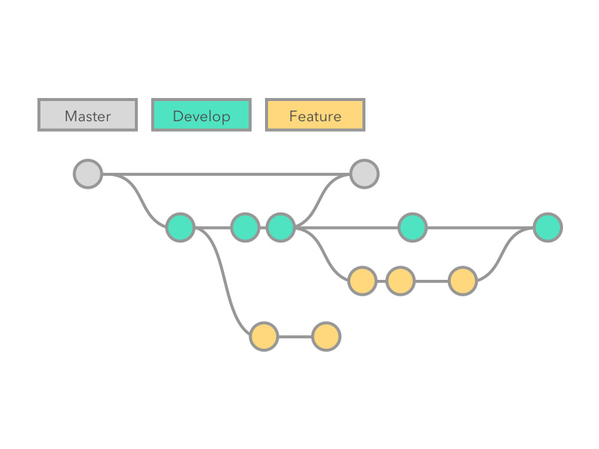
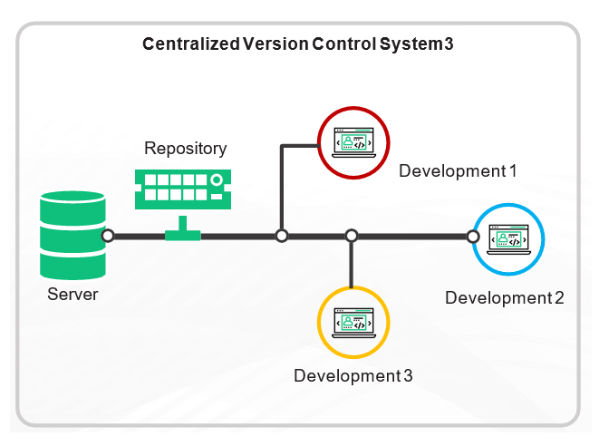


Version Controlling ?
A version control system allows users to keep track of the changes in software development projects and enable them to collaborate on those projects. Using it, the developers can work together on code and separate their tasks through branches.
Examples : GIT, CVS, SVN, Bitkeeper etc.

Slide 3
Types Of Version Controlling Systems
Local Version Controlling
Centralized Version Controlling
Distributed Version Controlling

Slide 4
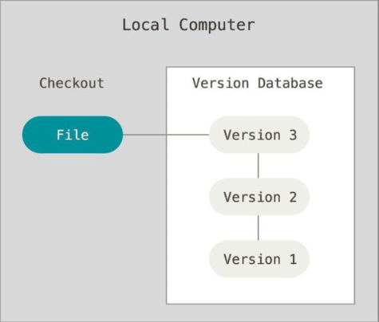
Local Version Controlling Systems

Slide 5
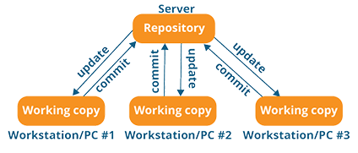
Centralized Version Controlling Systems

Slide 6
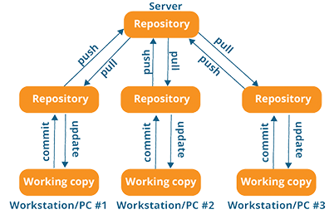
Distributed Version Controlling Systems

Slide 7
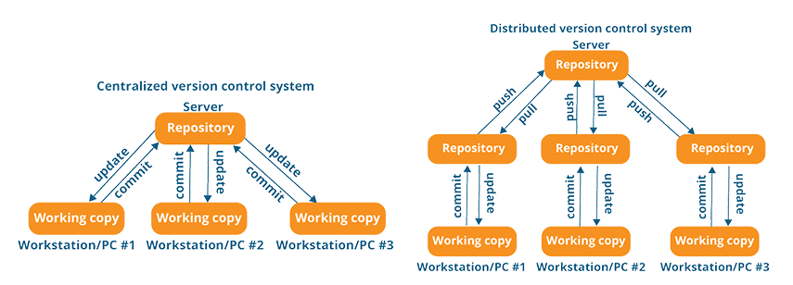
Centralized VS Distributed VCS

Slide 8
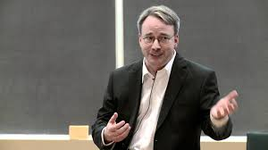


What Is Git ?
Introduction
Git (An open-source & distributed version controlling software ) was created by Linus Torvalds in 2005 for development of the Linux kernel, with other kernel developers contributing to its initial development. Its current maintainer since 2005 is Junio Hamano.
Bitkeeper & Linux Kernel Source Code
BitKeeper was first mentioned as a solution to some of the growing pains that Linux was having due to the use of patches in September 1998. On May 4, 2000, the first public release of BitKeeper was made available. BitMover Inc used to provide access to the system for certain open-source or free-software projects, one of which was the source code of the Linux kernel as the decision made in 2002 to use BitKeeper for Linux kernel development. In April 2005, BitMover announced that it would stop providing a version of BitKeeper free of charge to the community. Therefore, Git project was launched with the intent of becoming the Linux kernel's source code management software and was eventually adopted by Linux developers.
Linus Torvalds About GIT
https://www.youtube.com/watch?v=4XpnKHJAok8
Linus Torvalds
Founder of the Linux open-source operating system

Slide 9
How Version Controlling is done using branching and merging
To visualize that how branching and merging is done, please visit the link given below.
https://learngitbranching.js.org/

Slide 10
Advantages of git
Free & open-source
Fast & small in size.
Implicit Backup.
Distributed.
Every file and commit is check summed ( Git Integrity With Hash Values (SHA-1) ).
Branching is cheap and merging is easy.

Slide 11
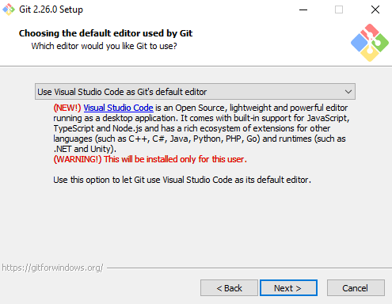
GIT Installation
Download Git from the link given below,
https://git-scm.com/downloads
Install it with completely default settings.
You can use default editor used by git of your own choice.

Slide 12
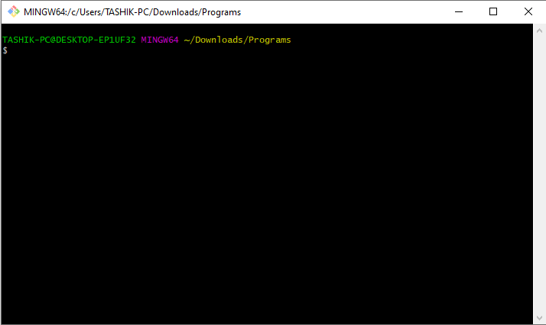
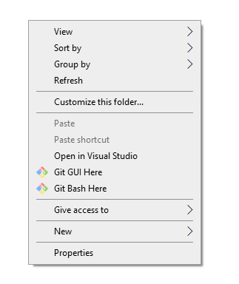
Introduction to git bash
- Right Click In Any Directory & Click “Git Bash Here”

Slide 13
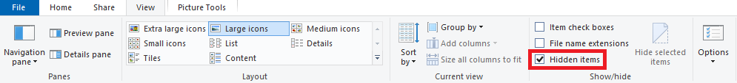
Introduction To GIT Commands
- Click ‘view’ option from the top of your folder settings &
mark the ‘Hidden items’ option. This will let you see the hidden files inside your current directory.

Slide 14
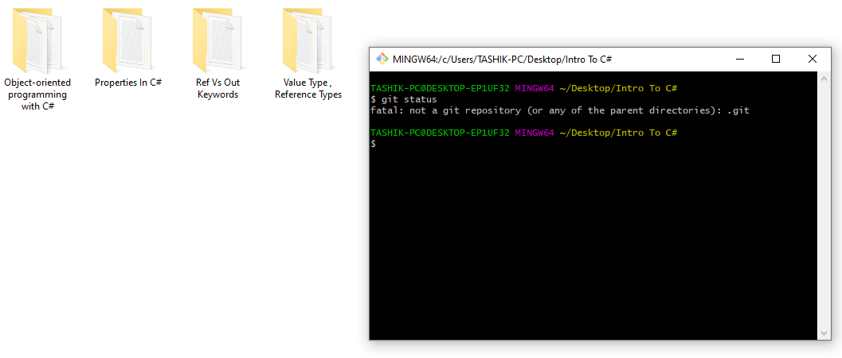
“git Status” Command in git vcs
The ‘git status’ command shows the current status of your folder. Currently, we do not have any git repository that is why the
‘git status’ command is showing “not a git repository” error message.

Slide 15
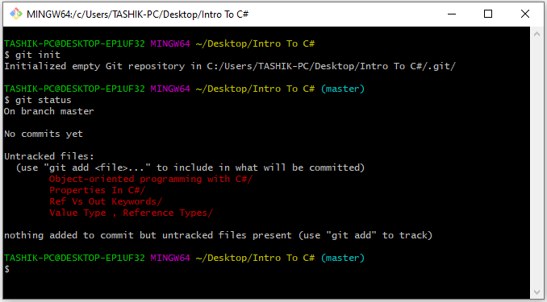
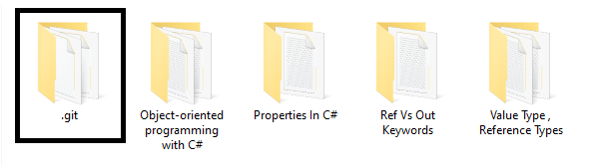
“git init” Command in git vcs
The ‘git init’ command creates and initializes a new repository inside your folder with the name provided.
It creates a ‘.git’ folder that by default is hidden but we can view this .git folder by enabling ‘Hidden files’ option from the view tab of our current directory.
If we use ‘git init <repository name>’ then it will create a new directory first with the repository name provided and then it will create a ‘.git’ folder and initialize a new repository inside that folder.

Slide 16
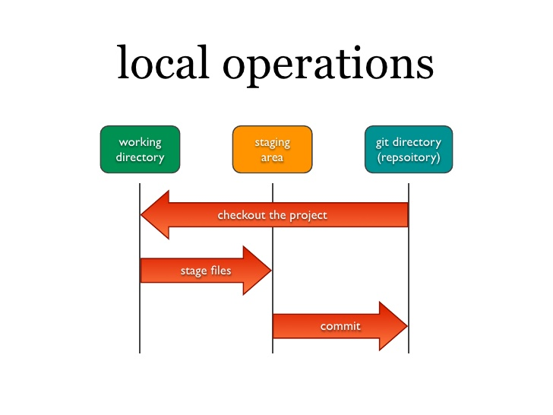
3 stage git vcs architecture

Slide 17
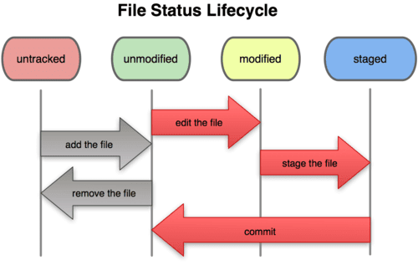
3 Stage git vcs architecture Cont

Slide 18
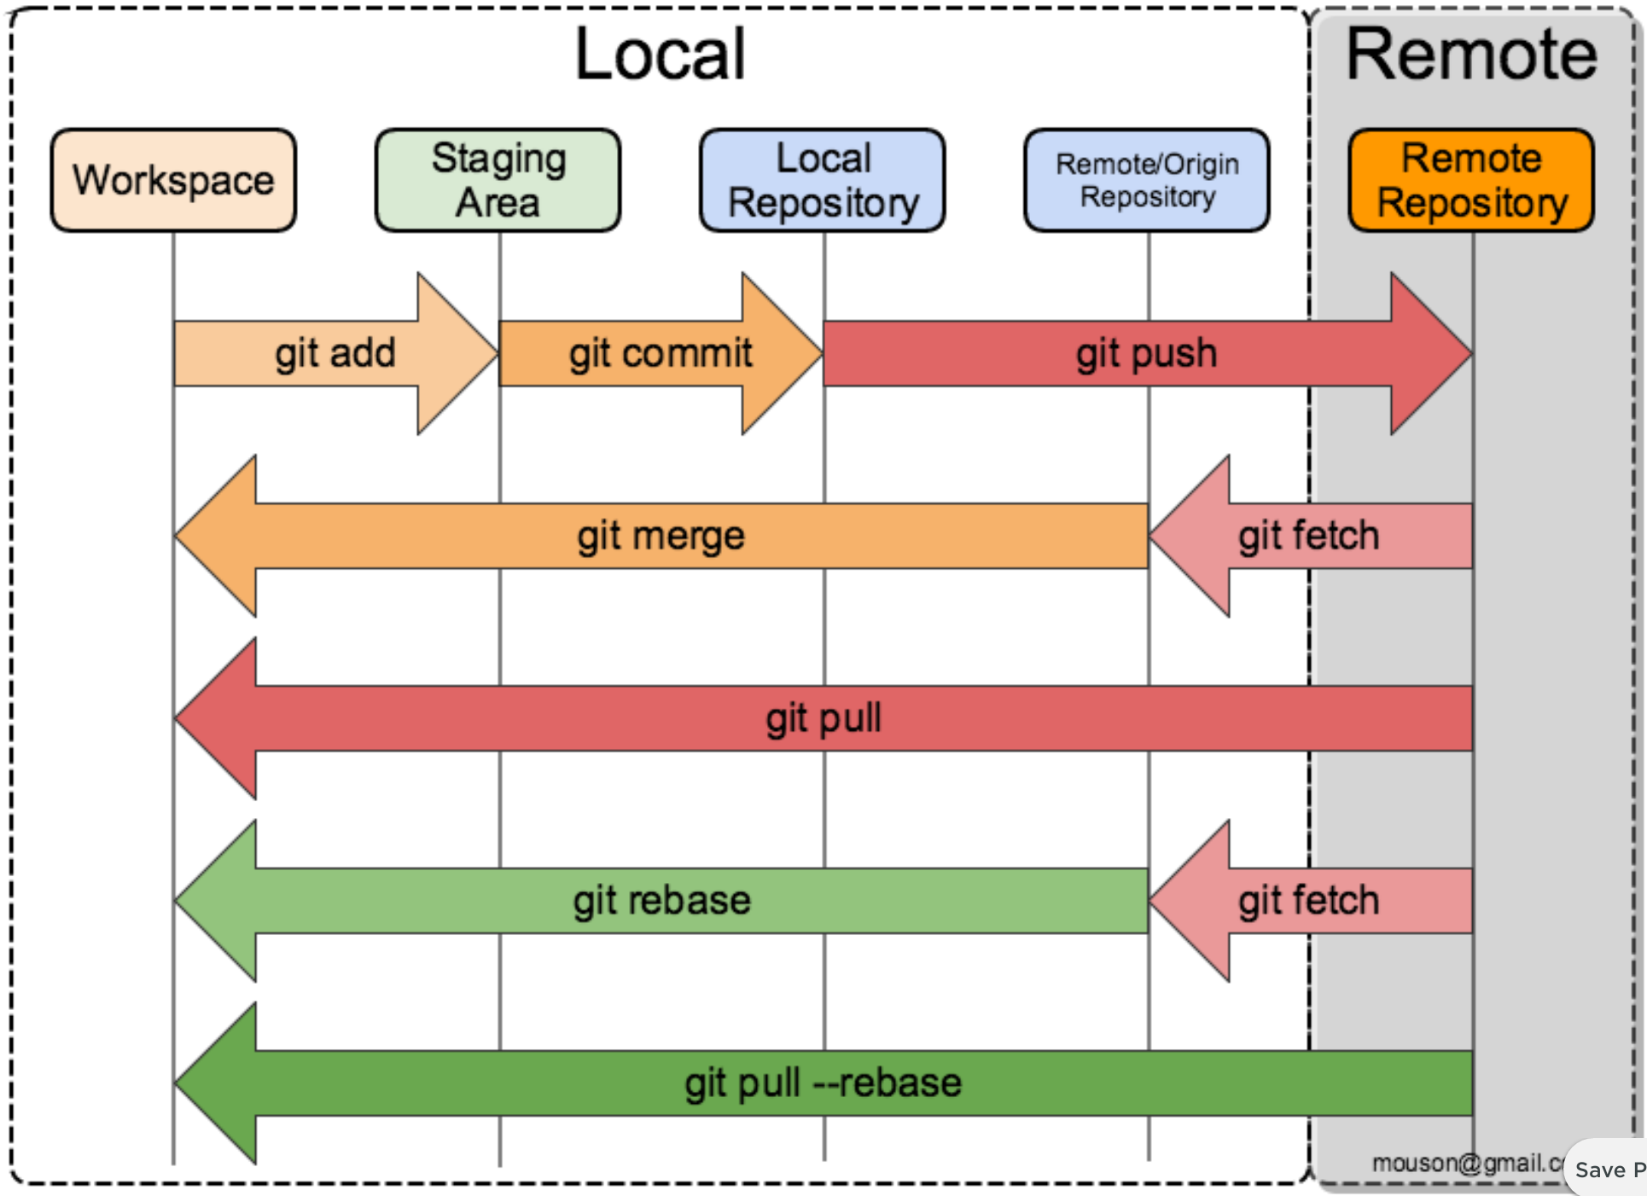
3 Stage git vcs architecture with remote repository

Slide 19
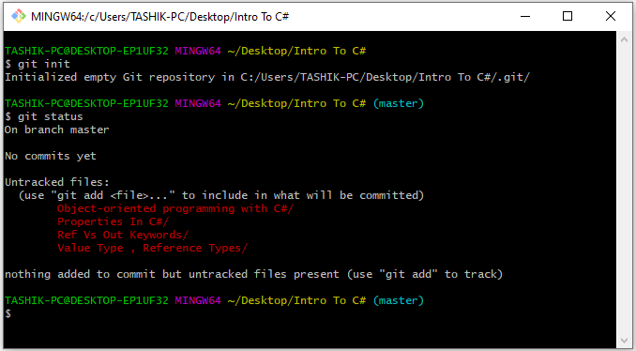
Untracked files in git vcs
- By default when we create a new repository, all the files/folder inside our repository are “untracked files/folders”

Slide 20
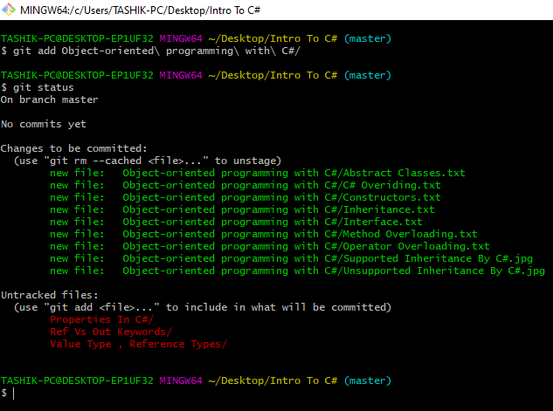
“git add” Command in git vcs
- In order to start tracking files inside
our repository, we use
‘git add <file/folder name>’.
- If we want to track/send all the files
To the staging area inside our repository, we use,
‘git add . ’.
OR
‘git add --a’.
- If we want to add some specific file that
has some specific extension to our staging area, then we use following version of git add,
‘git add *.cpp’.
// it will only send all the files having extension .cpp to the staging area.
- Through this command, we can start tracking our files/folders and we can put them inside the ‘Staging Area’.

Slide 21
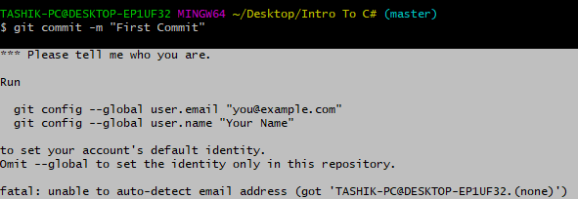
Configuring git vcs
Git will not allow you to commit without configuring your details because it has to maintain the history and the commits by name & email address to show what was committed and by whom.
Please configure yourself by using
following commands to commit any changes,
git config --global user.email “<YourEmail>”
git config --global user.name “<YourName>”

Slide 22
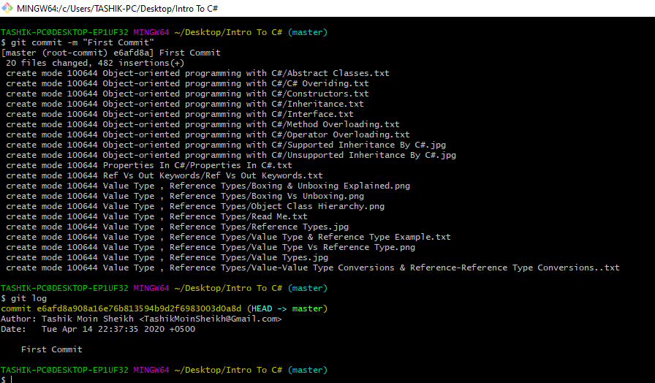
“git commit” Command in git vcs
git commit –m “<Any commit message>”
this command will commit all the files that are currently inside your staging area with a message provided.
For example,
“git commit –m “Bug Fixed”
git commit –a –m “<Any commit message>”
By using this command, you can directly commit your files without using git add command. This will first add all your files inside the staging area and then commit those files.
For example,
“git commit -a –m “Bug Fixed”

Slide 23
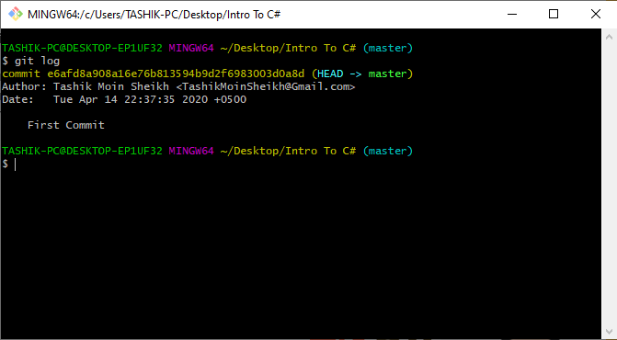
“git log” Command in git vcs
Git log command is used to show all the
commits made till now. It shows the commit message, author’s name & email who has committed the change and the date/time in which the change was committed.
It also shows a 40 characters long
hexadecimal format SHA-1 hash code of the commit. This SHA-1 hash code is used for git data integrity purpose.

Slide 24
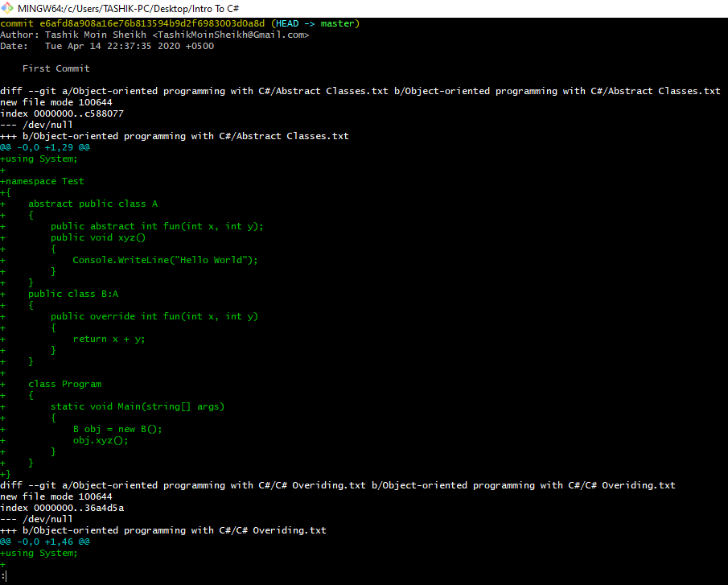
“git show” Command in git vcs
- The git show command is used to see the details of any specific commit. We provide it first 4 characters of the SHA – 1 hash code of any commit and it will display all the details & the changes made by this commit.
For example,
git show <First 4 characters of SHA-1 hash code of the commit>

Slide 25
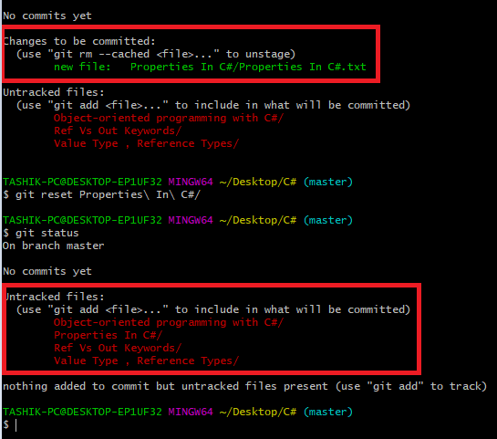
“git reset” Command in git vcs
- If we want to bring our files/folders back to the working directory, then we use reset command.
For example,
“git reset <file/folder name>”
- In order to bring every file/folder back to the working area from staging area we use,
“git reset ”
- If we want to unmodify all the modified files we use,
“git reset --hard”
- A single file can be unmodified by using ,
“git checkout head -- <file/folder name>”
OR
“git checkout <file/folder name>”
// It brings the old content back in our working directory from the last commit.
If we want to bring all the files/folders to their last commit state then we use,
“git checkout . “

Slide 26
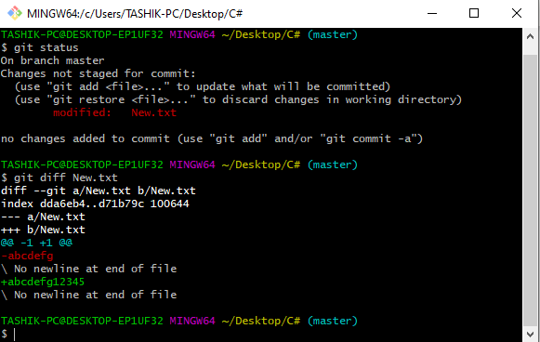
“git diff” Command in git vcs
It is used to see all the modifications made after any commit. It also shows the previous data as well as the updated one.
Example, “git diff New.txt”
// it shows the changes made in New.txt
- If we want to see the changes made in all the files/folders then we use,
“git diff . ”

Slide 27
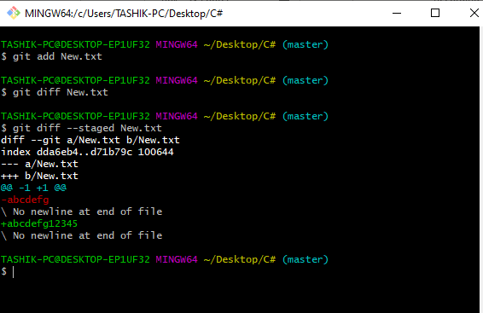
“git diff” Command in git vcs cont
- We can’t see the modifications done in our files if our file exist inside the staging area. In order to see the changes made in our files/folders inside the staging area we use --staged flag with the git diff command.
For example,
“git diff --staged <file/folder name>”

Slide 28
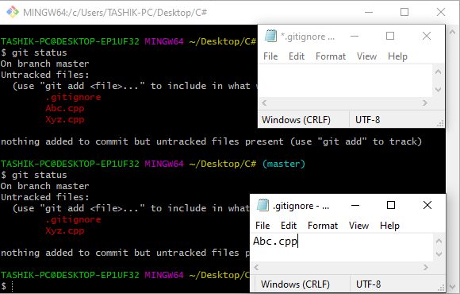
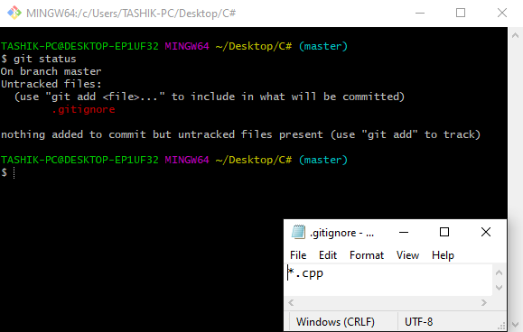
“.gitignore” file in git vcs
If we want to ignore some files that should not be tracked by git then we can ignore them using .gitignore file. we can ignore any file/folder by writing names of those files/folders inside this .gitignore file.
Note : Create this file using touch command to avoid any error.
Command to create .gitignore using touch : “touch .gitignore”.
If we want to ignore all the files of same extension then we can ignore all of them by using *.
For example,
“ *.cpp ”
We can all the appearances of any folder or any specific appearance by providing its path
For example,
“<Any Dir Name>/”(Ignores all the dir having this name)
OR
“ParentDirName/AnyChildDirName/”
(Ignores Only Specified Appearance Of Any Directory)
- By default every empty folder is ignored or not tracked by git.

Slide 29
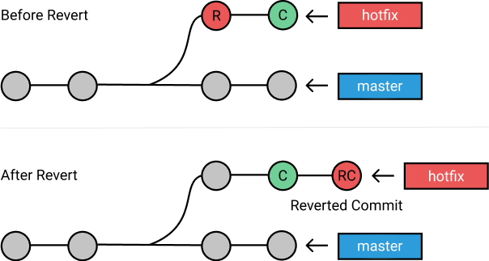
“git revert” Command in git vcs
- If we want to get the state of any previous commit back then we use git revert command. Git revert creates a duplicate of the node whose hash value is provided.

Slide 30
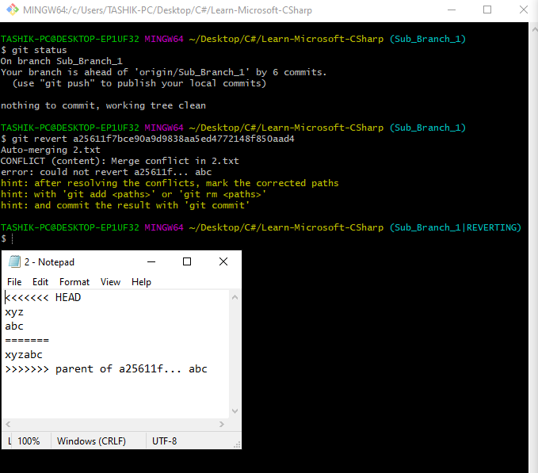
“git revert” command in git vcs cont
- Git revert also ask you to solve the merging conflicts. Suppose if we want some code from current state ( HEAD ) or latest commit and some from our previous state then we solve merge conflicts and make changes according to our requirements and then make a new reverted state.

Slide 31
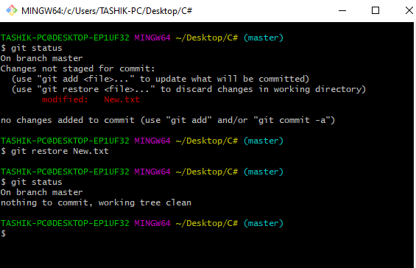
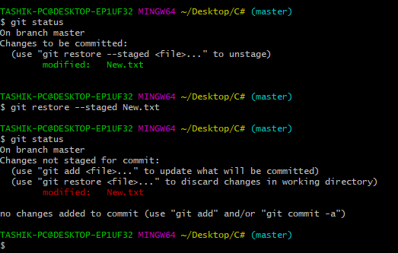
“git restore” Command in git vcs
- Git restore command is used to restore the changes made in a file/folder.
- To restore the files inside staging area we use --staged flag

Slide 32
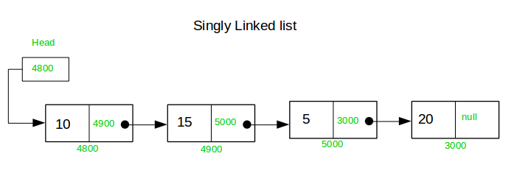
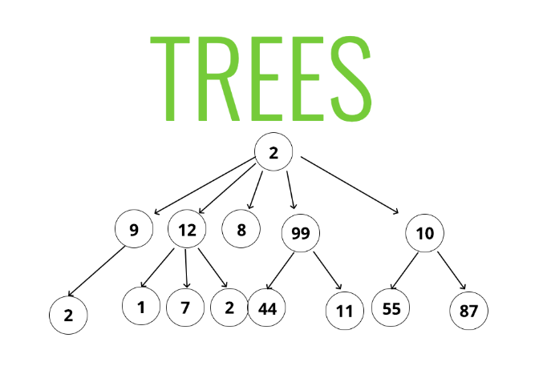
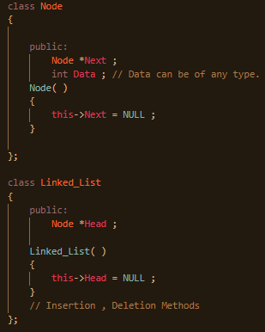
Linked List & Tree Data Structure
A linked list is formed when many such nodes are linked together by pointers to form a chain. Each node points to the next node present in the order. The first node is always used as a reference to traverse the list and is called HEAD. The last node points to NULL.
A tree data structure can be defined recursively as a collection of nodes (starting at a root node), where each node is a data structure consisting of a value, together with a list of references to other nodes (the "children"), with the constraints that no reference is duplicated, and none points to the parent nodes.

Slide 33
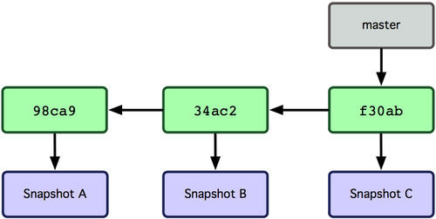
how data is being tracked in git vcs
Git creates a new node whenever a
commit is made, and the newly created node is pointed by the head pointer.
- The head pointer only points to the active branch. When we switch between the branches the head pointer also switches between the branches and starts pointing to the current active(working) branch.

Slide 34
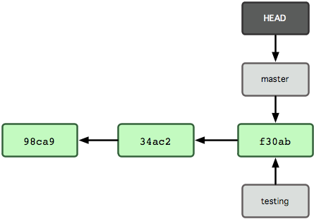
branches in git vcs
- A branch is like a parallel world where you can create commit without introducing bugs into production code. You can always fix the bugs before merging your branch into the production code
- A branch in Git is simply a lightweight movable pointer to one of these commits. The default branch name in Git is master . As you start making commits, you're given a master branch that points to the last commit you made.
- The head pointer only points to the active branch. When we switch between the branches the head pointer also switches between the branches and starts pointing to the current active branch.

Slide 35
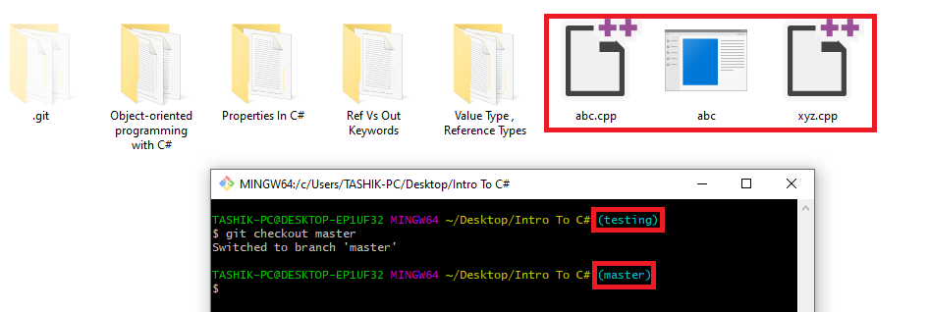
“git branch and git checkout” Command in git vcs
- To create a branch we use following command,
“git branch <Your Branch Name>”
For example,
“git branch testing”
To view all the current branches in our repository we write,
“git branch” // it will list all the branches.
To switch from one branch to another we use git checkout command,
“git checkout <branch name in which you want to switch>”
For example,
“git checkout testing”

Slide 36
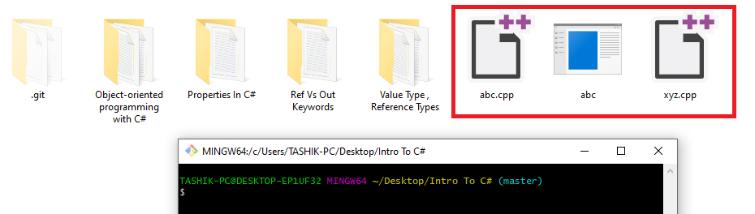
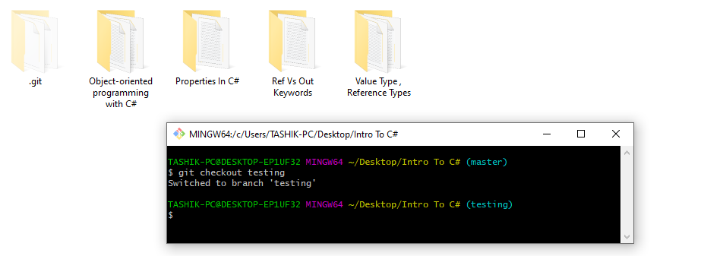
View Inside Master
View Inside Testing

Slide 37
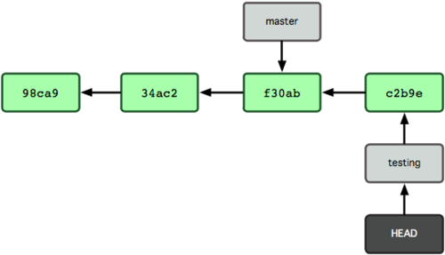
Branches in git vcs cont
- When we switch branches using git checkout command, the head pointer will now start pointing to the current active branch i.e. ‘testing’ in this case.
-Now whatever changes we commit; it will not effect the master branch. It’ll now only make changes inside our ‘testing’ branch. The master branch will be in the same previous state even if we commit any changes in our testing branch.
- We can switch back to our master branch using git checkout command if we want to make any changes(commit) in our master branch of code.

Slide 38
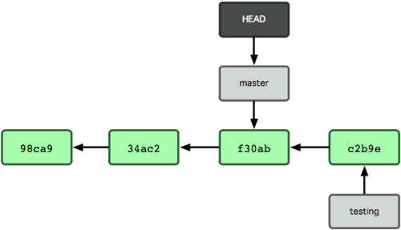
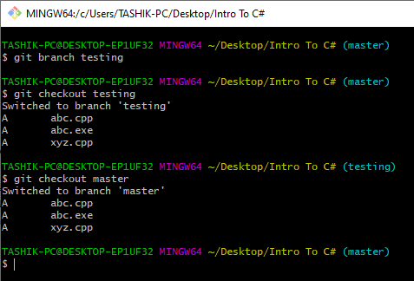
Branches in git vcs cont
- Previously, the head pointer was pointing to the testing branch. Now when we use “git checkout master” command to switch back to our master branch it starts pointing to the master branch again.

Slide 39
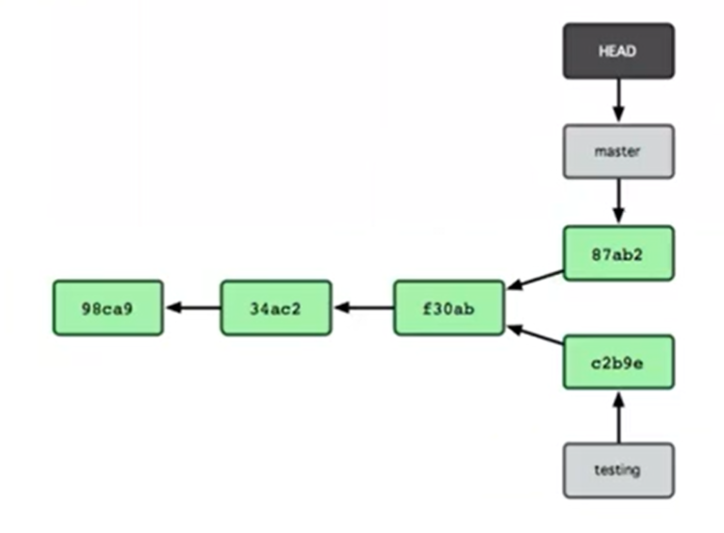
Branches in git vcs cont
-Now if we commit any changes in our master branch, then it will create a new node and master pointer will start pointing to the new commit(changes) or newly taken snapshot.

Slide 40

Introduction to remote repository

Slide 41
Types of repositories in GitHub
There are two types of repositories in GitHub:
Public: Anyone can see and try to contribute
Private: Only the ones that you allow to see and contribute can do so

Slide 42
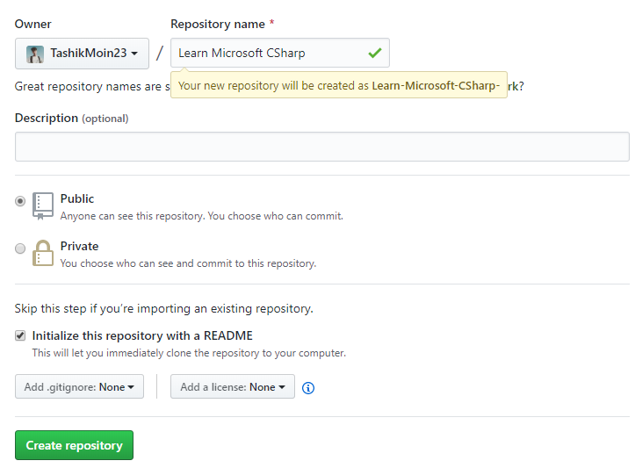
Creating Our First Remote Repository at Microsoft GitHub
First Sign-in in your GitHub Account.
Go to “My Repositories”.
Click “New”.
Name Your Remote Repository & Click Create Repository.
Note : Initializing a ReadMe file will make an implicit commit and it will add a ReadMe file in your remote repository.

Slide 43
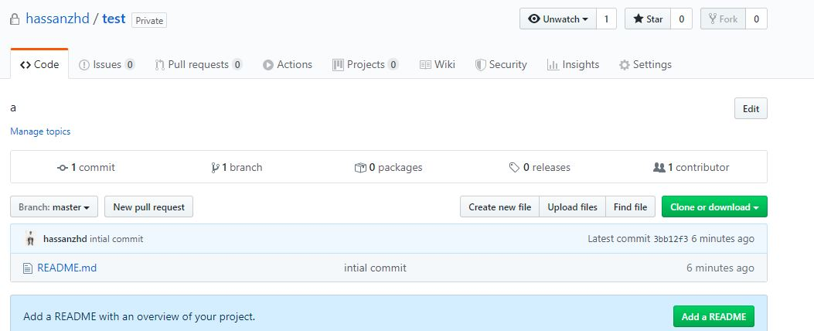
Creating Our First Remote Repository at Microsoft GitHub Cont

Slide 44
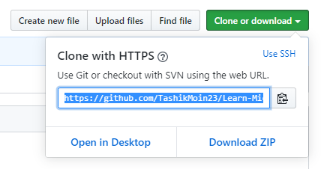
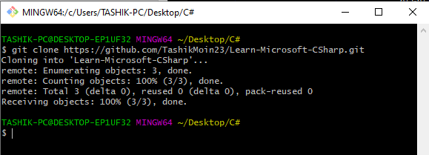
“git clone” command int git vcs
-It brings the content of your remote repository to your local machine.

Slide 45
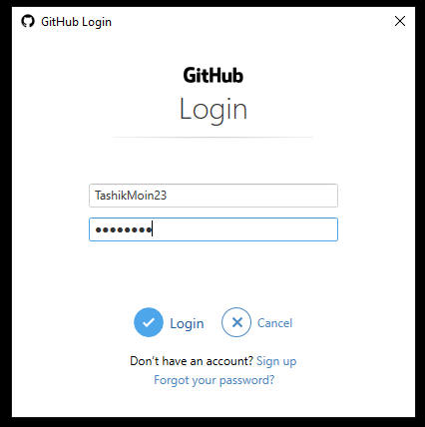
Login to github through git

Slide 46
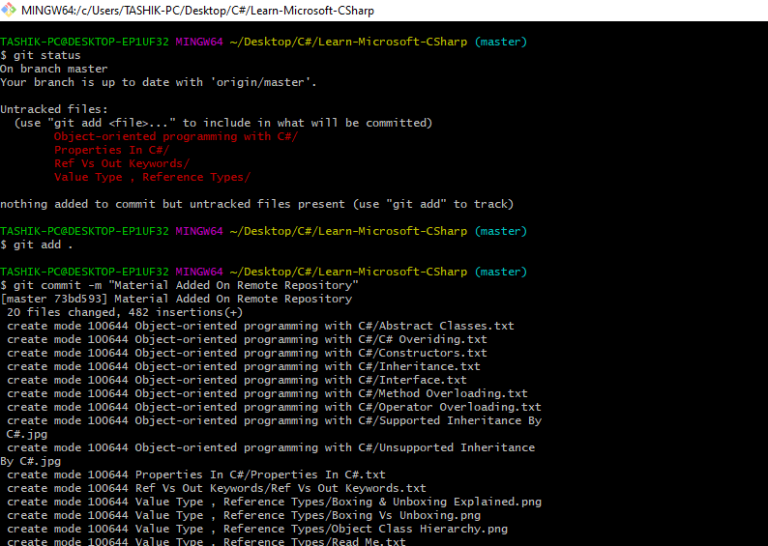
Committing in local repository the content of our remote repository

Slide 47

Pushing/committing in GitHub remote repository using git

Slide 48



Branches with git and github
If we create a new branch in our local machine and we want to push that branch in our remote repository, then we use push command with –u flag.
git push <alias> <branch to be pushed>
OR
git push –u <alias> <branch to be pushed>

Slide 49

View of our remote repository after the commit

Slide 50

Workflow with microsoft GitHub
- If we clone any repository from GitHub, then initially it will create duplicates of all the branch pointers from our server repository to our local cloned repository.

Slide 51

Workflow with microsoft GitHub COnt
- The branch pointers of our remote repositories can move forward because the people in your team can commit changes any time inside the remote repository. Now if you try to push something it will first ask you to first pull the latest changes made in your remote repository. The pull statement or the pull command brings the latest remote repository content & it also merge the changes made in your local repositories with the remote repository by default and if there exist any merge conflict it ask you to solve these merge conflicts first in order to push changes inside our remote repository.

Slide 52

Workflow with microsoft GitHub COnt

Slide 53
“git remote -v” Command in git vcs
git remote –v is used to view all set remote repositories in the current local repository

Slide 54
“git remote add” Command in git vcs
git remote add is used to add remote repositories to local repository. Alias is the name that will be used over the URL

Slide 55

“git push” Command in git vcs
git push is used to move committed changes onto the remote repository. If branchName is anything other than master then they are not directly added, this procedure is called pull requests and will be discussed later

Slide 56

“git pull” Command in git vcs
git pull is used to get all the updated content which has been committed to the remote repository. If master branch of local is up to date then git prompts “Already up to date”

Slide 57

“git push” Command in git vcs
git push can also be used to push local branches to remote. This is done in-order to perform pull requests, as no content is merged with master directly. Without the review of a project manager/ lead.

Slide 58

“git push” Command in git vcs Cont
This command deletes the localBranch from the remote repository

Slide 59

RUNNING SOME COMMANDS

Slide 60
Pull requests
Pull requests are a feature which allow Pull you to tell others about changes you've pushed to a branch in a repository on GitHub. Once a pull request is opened, you can discuss and review the potential changes with collaborators and add follow-up commits before your changes are merged into the base branch. (source: help.github.com)

Slide 61
Pull requests Continued
STEPS:
We switched to test branch
We edited README.md
We added README.md
We committed README.md
We opened our repository in GitHub and clicked “compare and merge”
As GitHub tells us, we can successfully merge we click “merge pull request”
All changes of test branch are combined with master branch
In order to get those changes in local master branch we do :
git checkout master
git pull

Slide 62


Slide 63


Slide 64

Thank you.

